Slide 1
Word Embedding Tutorial
National Chung Hsing University
yfan@nchu.edu.tw
Yao-Chung Fan

Slide 2
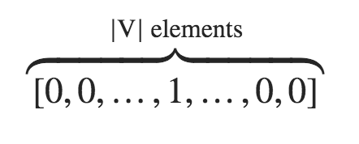
Main Problem (1/2)
Word embeddings are dense vectors of real numbers, one per word in your vocabulary.
A basic representation is one-hot-encoding form
That is, we represent the word w by
where the 1 is in a location unique to w. Any other word will have a 1 in some other location, and a 0 everywhere else.

Slide 3
Main Problem (2/3)
The mathematician ran to the store.
The physicist ran to the store.
The mathematician solved the open problem.
Let’s think one-hot-form of ”mathematician” and “physicist” ?
Physicist = [0, 0, 0, 0, 0, 1]
mathematician = [0, 0, 0, 0, 1, 0]
ran=[0, 0, 0, 1, 0, 0]
store=[0, 0, 1, 0, 0, 0]
solve=[0, 1, 0, 0, 0, 0]
problem=[1, 0, 0, 0, 0, 0]
Semantic Similarity ?

Slide 4
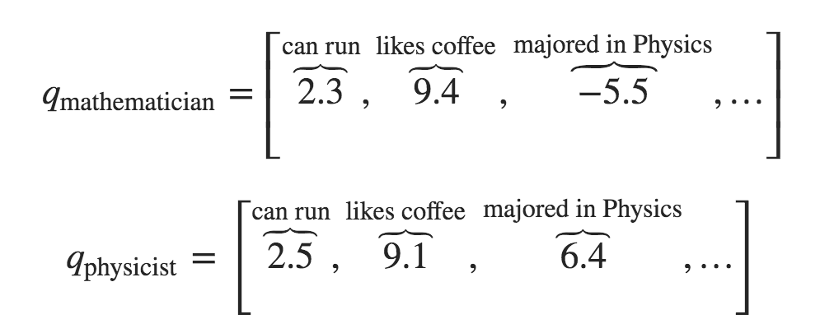
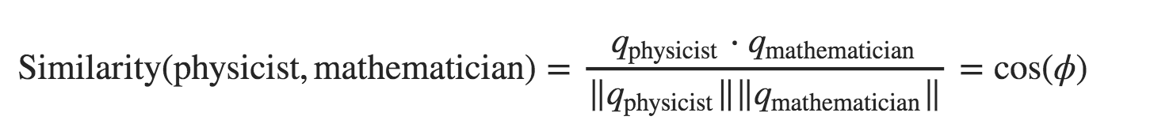
Main Problem (3/3)
How can we solve this problem? That is, how could we actually encode semantic similarity in words? Maybe we think up some semantic attributes.
For example, we see that both mathematicians and physicists can run, so maybe we give these words a high score for the “is able to run” semantic attribute
If each attribute is a dimension, then we might give each word a vector, like this:

Slide 5
Main Idea(1/3)
The mathematician ran to the store.
The physicist open the store.
How about learn a word embedding from data ?
The fundamental idea is to cast the learning problem by a binary classification problem.
L(mathematician, ran) = 1
L(ran, store) = 1
L(physicist, open) = 1
L(open, store) = 1
P(mathematician, ran) = 1
P(ran, store) = 1
P(physicist, open) = 1
P(open, store) = 1
Classification
Model
L(mathematician, store) = 0
L(mathematician, open) = 0
L(physicist, ran) = 0
P(mathematician, store) = 0
P(mathematician, open) = 0
P(physicist, ran) = 0

Slide 6
Main Idea(2/3)
L(mathematician, ran) = 1
P(mathematician, ran) = 1
?
P(v_{mathematician}, v_{ran}) =
e.g,
V_{m}=[0, 1, 1]
V_{r}=[0, 0, 1]

Slide 7
Main Idea(3/3)
Find encodings/representations/vectors
v_{Mathematician}
v_{Physicist}
v_{Store}
v_{Open}
v_{Ran}
subject to
Minimize the following error:
L(mathematician, ran) = 1
L(ran, store) = 1
L(physicist, open) = 1
L(open, store) = 1
L(mathematician, store) = 0
L(mathematician, open) = 0
L(physicist, ran) = 0
Notes:
(1-L(w_i,w_j))\cdot P(w_i,w_j)+ L(w_i,w_j)\cdot(1-P(w_i,w_j))

Slide 8
Word2vec

